Slide 1

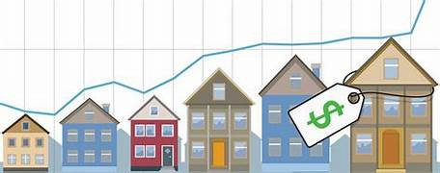
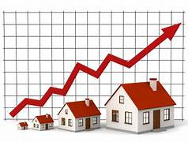

Banglore house price prediction model
MAJOR PROJECT 2 PRESENTATION

Slide 2



CONTENT
01 02
03
04
05
06
07
08
INTRODUCTION
MOTIVE
OBJECTIVE
PROBLEM STATEMENT
CORE AREA OF PROJECT
PROS AND CONS OF PROJECT
SOFTWARE REQUIREMENTS
HARDWARE REQUIREMENTS
09
METHODOLOGY
10
TEST AND VALIDATION
11
CONCLUSIONS

Slide 3

INTRODUCTION
Bangalore, often referred to as the "Silicon Valley of India," has seen rapid urbanization and a booming real estate market. Predicting house prices in this dynamic market is crucial for home buyers, sellers, and investors to make informed decisions.
Bangalore House Price Prediction Model leverages machine learning techniques to analyze historical housing data and forecast property prices based on various factors. The model considers key attributes such as location, square footage, number of bedrooms, amenities, and market trends to provide accurate price estimations.

Slide 4


MOTIVE
The basic motive for making this model is for:
Data-Driven Decision Making 📊:To help buyers, sellers, and investors make informed real estate decisions based on historical trends and market analysis.
Price Transparency & Fair Valuation 💰:To provide accurate and fair property price estimates, reducing price discrepancies and speculation.
Predict Market Trends 📈:To analyze real estate patterns and forecast future price fluctuations in Bangalore’s dynamic housing market.
Support Real Estate Businesses 🏢:To help real estate agencies, property developers, and financial institutions make strategic pricing and investment decisions.

Slide 5




OBJECTIVES AND PROBLEM STATEMENT
Objective n° 1
Objective n° 2
Objective n° 3
Objective is to develop an accurate and reliable system that can estimate house prices based on various factors
Provide Data-Driven Insights for home buyers, sellers, and investors.
Reduce Price Uncertainty and ensure fair property valuation.
PROBLEM STATEMENT
Bangalore's real estate market is highly dynamic and influenced by multiple factors such as infrastructure development, demand-supply variations, and economic conditions. Traditional pricing methods often lack accuracy, leading to overpricing,lack of transparency etc there fore we use advanced ML algorithms to analyze large datasets and provide real-time, data-driven price estimations for better decision-making in the real estate sector.

Slide 6
CORE AREA FOR PROJECT
The success of this project depends on several core areas that define its functionality, accuracy, and impact. Here are the key focus areas:
Data Collection & Preprocessing 📊:Cleaning and preprocessing data to handle missing values, duplicate entries, and inconsistencies.
Feature Selection & Engineering ⚙️:Identifying key factors affecting house prices, such as location ,property size, market Trends etc.
Machine Learning Model Development 🤖:Gradient Boosting (XG Boost, Cat Boost, Light GBM) – For high accuracy and efficiency. Linear Regression – For basic price trend predictions.
Model Training & Optimization 🚀:Training models on historical housing data to predict future prices also optimizing models by tuning hyperparameters and avoiding overfitting.
Deployment & User Interface 🖥️:Developing a web-based or mobile application for easy user interaction.

Slide 7



PROS AND CONS OF THE METHOD
PROS
Uses machine learning to analyze large datasets and predicts house prices with high precision.
Helps buyers, sellers, and investors make informed real estate decisions based on trends rather than speculation.
PROBLEM 2
If the dataset is incomplete or outdated, the model’s accuracy may decrease.
The model may not capture instant price changes caused by sudden demand spikes or infrastructure projects.

Slide 8







SOFTWARE REQUIREMENT
A set of instructions or program required to make hardware platform suitable for desired task is known as software. Software can also be defined as the utility programs that are required to drive hardware of computer
PYTHON NUMPY
Google Colab TENSERFLOW
XGBoost
Marplotlib and Seaborn

Slide 9



HARDWARE REQUIREMENT
All the physical equipment’s i.e. input devices, processor, and output device & inter connecting processor of the computer s called as hardware.
Hard disk minimum of 40 GB
Ram mnimum of 16 GB
Dual Core and up ,15” Monitor.
Processor intel core i7/i9.

Slide 10
METHODOLOGY
In the process of developing this model, various machine learning algorithms were studied. The model is trained on Support vector machines (SVM), random forest, XG Boost, Lasso regression, and linear regression. Out of this Random Forest gives highest accuracy in prediction of housing prices and the next highest accuracy achieved is by XG Boost algorithm and this algorithm is preferred due to its ability to handle complex, structured datasets and its ability to automatically handle missing values and outliers. Therefore, we recommend the use of XG Boost for house price prediction tasks in the real estate industry. The decision to choose the algorithm depends on the dimensions and type of data used. XG Boost is the best fit for our model.
XG Boost: The XG Boost observes features of an attribute and train the model by analyzing given features. XG Boost from the graph, attribute combination, labels including features and according to the system analyzes the data.

Slide 11
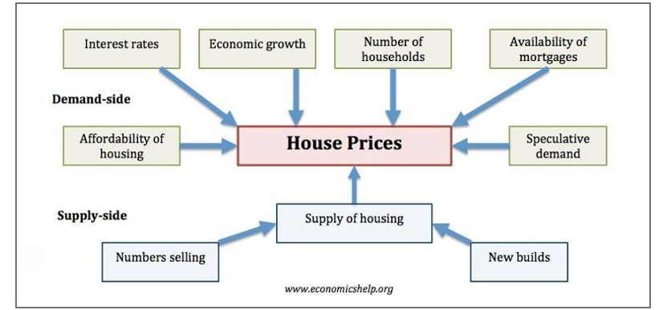
FACTORS AFEECTING HOUSE PRICING
UNEMPLOYMENT
ECONOMIC GROWTH
INTREST RATES
CONSUMER CONFIDENCE
MORTGAGE AVAILABILITY
SUPPLY
These are some factors that affects house pricing

Slide 12

CONCLUSION
The goal of the project "House Price Prediction Using Machine Learning" is to forecast house prices based on various features in the provided data. Our best accuracy was around 90% after we trained and tested the model. To make this model distinct from other prediction systems, we must include more parameters like tax and air quality. People can purchase houses on a budget and minimize financial loss. Numerous algorithms are used to determine house values. The selling price was determined with greater precision and accuracy. People will benefit greatly from this. Numerous elements that influence housing prices must be taken into account and handled.

Slide 13


REFERENCES
House price prediction using a hedonic price model vs an artificial neural network. American Journal of Applied Sciences. Limsombunchai, Christopher Gan, and Minsoo Lee. 3:193–201.
1.Joao Gama, Torgo, and Luis. Logic regression using Classification Algorithms. Intelligent Data Analysis. 4:275-292.
1.Real Estate Economics. Heidelberg, Bork M. and Moller VS, House Price Forecast Ability: A Factor Analysis. 46:582–611.
Jae Kwon Bae, Byeonghwa Park. Housing Price Forecast Using Machine Learning Algorithms. 42:2928–2934.

Slide 14
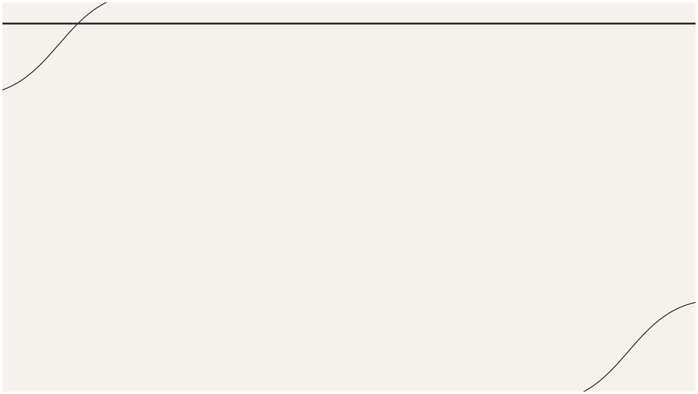
Thanks!
MADE BY: YASH GINOYA,KARAN SONI,MAYANK BHATT
ENROLLMENT NO: 92100151001, 92100151015, 92100151048

